Slide 1
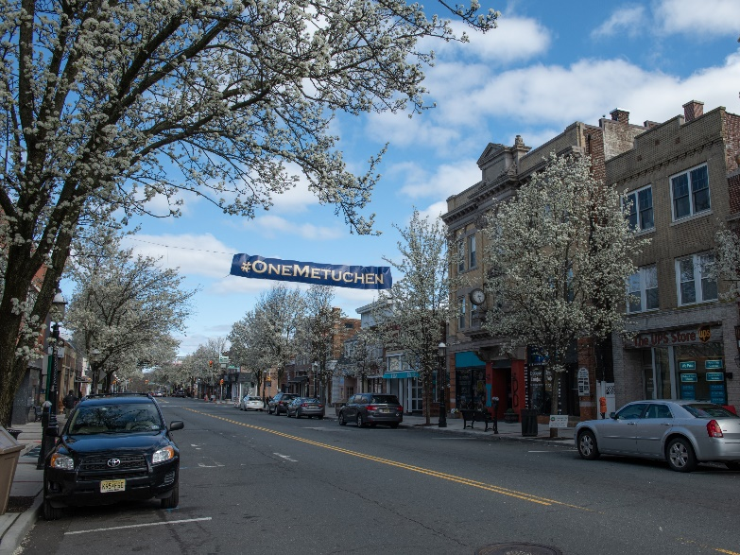
Borough of Metuchen, New Jersey
2024 Proposed Budget Review
Melissa Perilstein
Borough Administrator
April 8, 2024

Slide 2
2024Budget Review
Proposed municipal budget is $ 27.47 M
Reflects local 1.5330 to 1.5750 tax point increase for taxpayers (rounding allowance)
Budget relies on:
$1,780,000 in surplus funds
$250,000 contribution from Parking Authority
$1,541,484 State Aid
$1,829,688 from fees, permits, licenses, etc.*
$430,000 from delinquent tax collection
$3,334,574 from grants, other sources * subject to change
$17,275,374 through municipal property taxes
$1,029,515 through library property taxes
Notes:
*courts fees, interest on taxes, meters and interest on investment

Slide 3
Proposed 2024 Budget Allocation
Notes:
29% Other:
Recreation
Library
Shared Service Agreements
MCUA Charges

Slide 4
2024/2023 Year Change

Slide 5
Where Your Taxes Go
Year Over Year Change:
Schools (est)– $250.00 Borough – $84.00
County (est) –$62.00 Library –$6.00

Slide 6
General Capital Budget 2024
2024 General Capital Authorized = $6,455,980
2024 5% Downpayment in budget/capital fund = $258,000
2024 NJDOT Municipal/Transit Aid = $1,483,980
Bonds & Notes Authorized = $4,614,000

