Slide 1
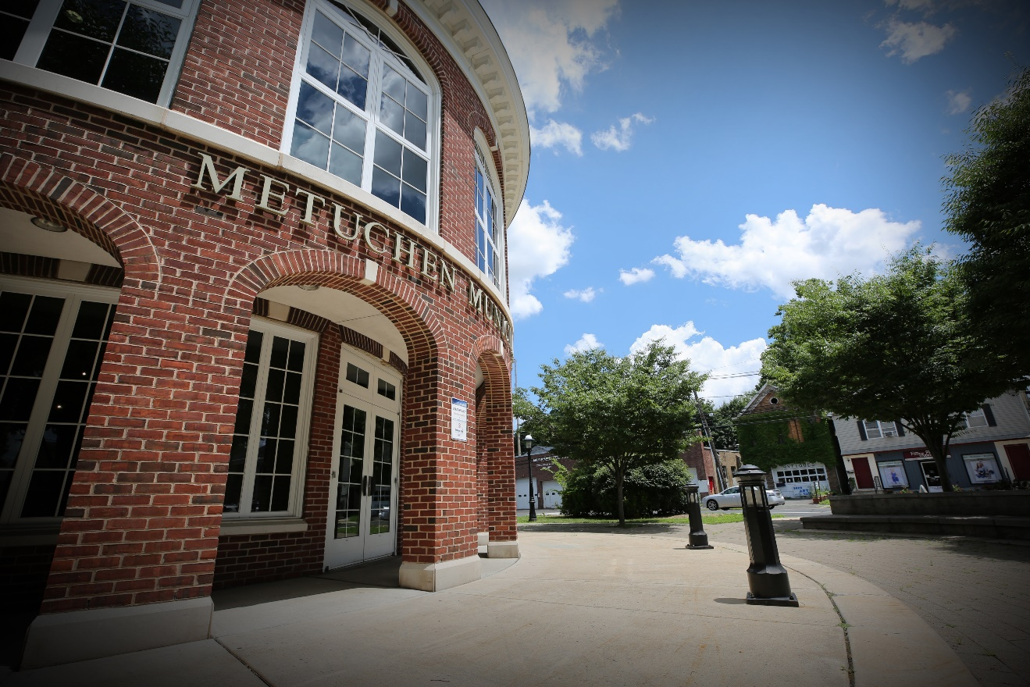
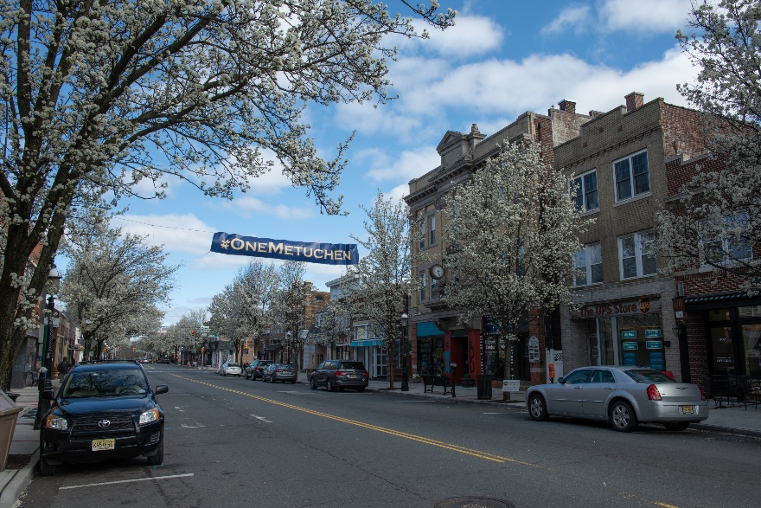
Borough of Metuchen, New Jersey
2022 Proposed Budget Review
Melissa Perilstein
Borough Administrator
May 9, 2022

Slide 2
2022 Budget Review
Proposed municipal budget is $ 22.7M
Reflects 2022 local tax rate of 1.458 from 2021 tax rate 1.421 (rounding allowance)
Budget relies on:
$1,100,000 in surplus funds(utilizing $ 275,000 less of surplus)
$250,000 contribution from Parking Authority
$ 1,448,954 State Aid (no change from 2021)
$ 572,087 from fees, permits, licenses, etc.
$ 550,000 from delinquent tax collection
$ 323,640 from grants, other sources (subject to change)
$ 16,018,844 thru municipal property taxes
$ 910,486 thru library property taxes
$ 761,097 thru American Recovery Act – replacement of revenue COVID

Slide 3
Proposed 2022 Budget Allocation
Notes:
Recreation
Library
Shared Service Agreements
MCUA Charges

Slide 4
2022/2021 Year Change
Notes:
.

Slide 5
Where Your Taxes Go
Year Over Year Change:
Schools (est) – $181.69 Borough – $74.96
County (est) –$41.54 Library – $13.80

Slide 6
American Recovery Act
$761,097 – total replacement of revenue loss
Allocated for revenue loss
Notes:
Last year for this revenue replacement from the federal government

Slide 7
Capital Expenditures $
Milling & Paving $1,151,900
Woodside Ave. , Rose Street, Lowell Ave.
Public Works $761,000
One automated garbage truck
Pick up truck
Police Department $175,000
Rifle Suppressors
Alcotest
2 police vehicles
Fire Department $100,000
SCBA Replacement
Digitization of Planning/Zoning Records $140,000
$ 492,900 Borough Contribution
Sewer Utility truck
Tree truck
LiveScan fingerprint equip
Halsey Street Lot – Reimburse by Parking Authority $203,500
Douglas Dr., Dolores Dr. Michael Dr.
Lynn Circle , Robert Circle
$ 659,000, Grants

Slide 8
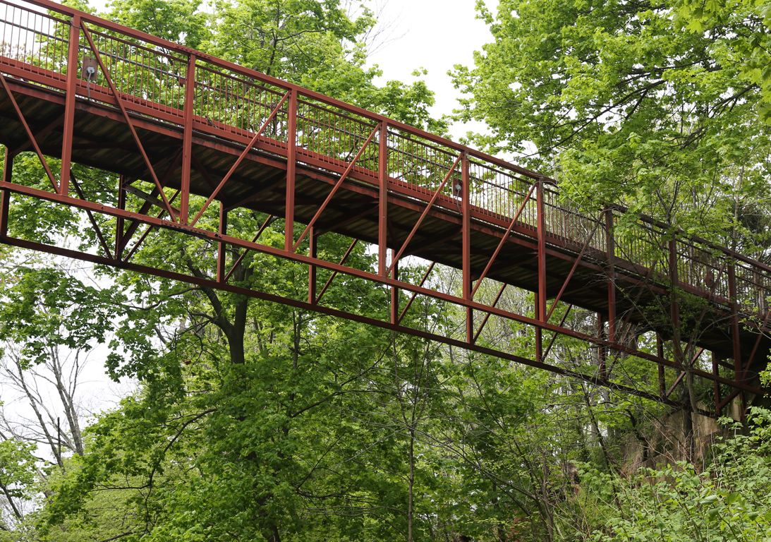
Kahn’s Crossing Bridge Replacement
$425,000
Sources for Funding:
Capital Budget $123,000
NJDOT Grant $302,000

