Slide 1
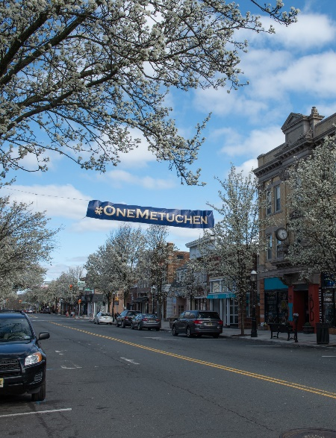
Borough of Metuchen, New Jersey
2020 Proposed Budget Review
Melissa Perilstein
Borough Administrator
July 13, 2020

Slide 2
2020 Budget Review
Proposed municipal budget is $22.25M
Decrease of $492,784 from 2019 budget (capital improvement section)
Reflects 4.5 to 4.6 tax point increase for taxpayers (rounding allowance)
Budget relies on:
$1,600,000 in surplus funds
$500,000 contribution from Parking Authority
$1,448,955 in State Aid
$662,264 from fees, permits, licenses, etc.
$600,000 from delinquent tax collection
$368,148 from grants, other sources * subject to change
$14,855,112 thru municipal property taxes
$808,413 thru library property taxes

Slide 3
Proposed 2020 Budget Allocation

Slide 4
2020/2019 Year Change
Notes:
.

Slide 5
Where Your Taxes Go
Year Over Year Change:
Schools – $226.00 Borough – $90.00
County (est) – ($36.00) Library –$4.00

Slide 6
Equipment & Construction
PUBLIC WORKS
One garbage truck
ROADS
Milling & Paving of
Desser Place
Ross Street
McCoy Ave.
Brunswick Ave.
Lake Ave.
Stoneham Place(Revere Ct. & Hale Ct.)
ADA sidewalk and curbs at end if Lake Ave.
Notes:
To highlight some of the projects and equipment to be funded in this year’

Slide 7
COVID 19 Loss of Revenues
Estimated $500,000 loss of revenue to 2020 budget which is a direct result of COVID19 pandemic.
Two major sources are municipal court and parking authority.
*Estimate excludes delinquent taxes.*

Slide 8
COVID 19 Expenditures
Estimated $102,000 non-salary/wage utilized to cover cost related to COVID19 and anticipating these expenses will be reimbursed under Middlesex County Cares Act or FEMA

